Slide 1
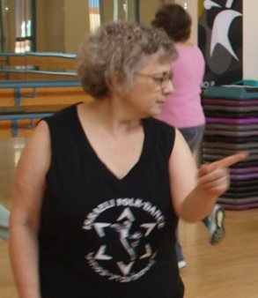
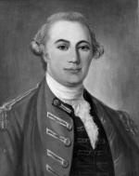
Auric (the car) in Pittsburgh
Starring
Auric Goldfinger the car
Cherie Maharan
John Forbes
Marc Rauer, from Behind
Notes:
Cherie.jpg, lynn.jpg, marc rauer.jpg, john forbes.jpg, yaron ben simchon.jpg, idan Raichal.jpg

Slide 2
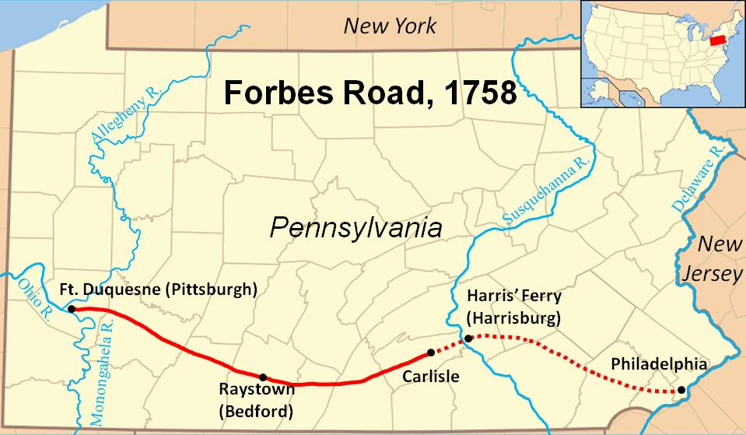
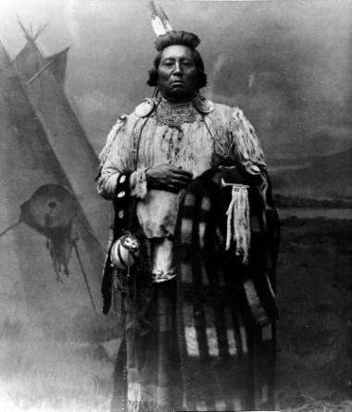
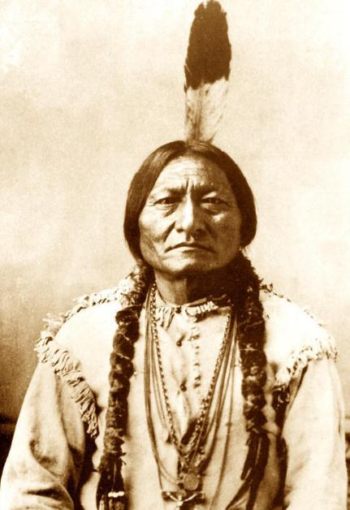
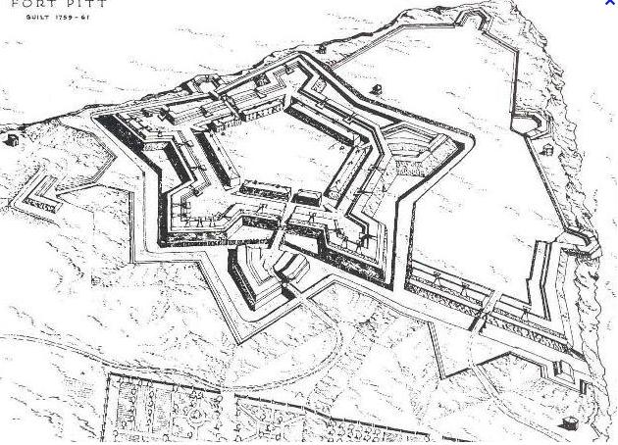
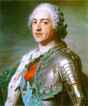
Below, left, is Gen John Forbes, the British General in charge of British American forces in the French and Indian War of the middle 1700’s.
He wanted to invest Fort Duquesne where Pittsburgh is today. To do so, he adopted a multi level strategy.
Extended and reengineered the Braddock road (built by the previous commander) to move men and supplies to the front (Ft Duquesne)
Make treaties with the Indian tribes to keep the tribes from supporting the French
Surrounded (invested) Fort Duquesne as the French abandoned the fort
Created a new fort, Fort Pitt, which is the basis of present day Pittsburgh
An unintended consequence of the Braddock road was to cement Pennsylvania’s claim to this region (against other colonies, especially Virginia) defining the state’s borders
Notes:
john forbes.jpg, ft pitt.jpg, indian1.jpg, indian2.jpg, louisxv.jpg, louis.another.jpg, braddock road.jpg

Slide 3
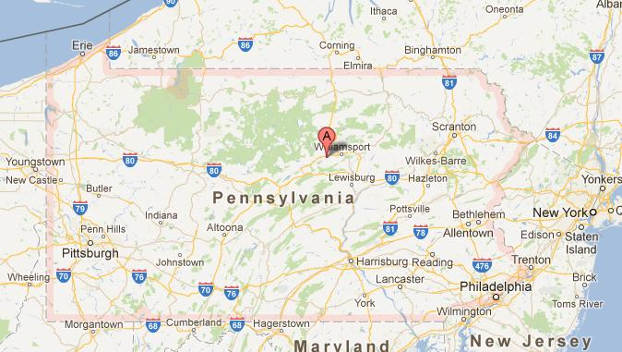
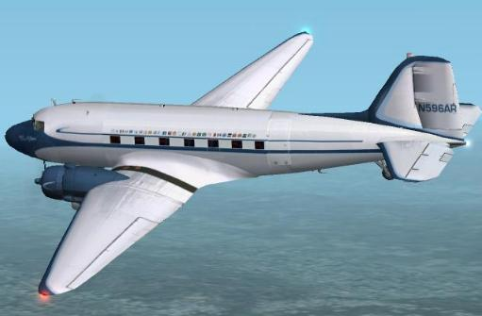
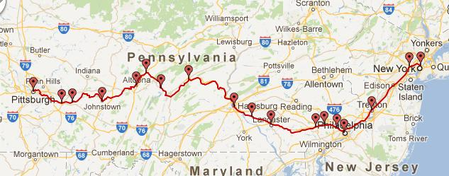
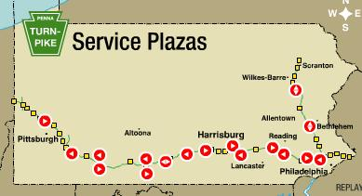
Getting to Pittsburgh
Your Instructor decided to go by car. The trip from Phila to Pittsburgh is best done by the Pennsylvania Turnpike (which incidently follows Braddock and Forbes road.
The trip by car is 5 hours. By Air it is less than an hour of flight time but this does not include time spent at the airports.
Amtrak provides service from Phila to Pittsburgh but the trip is over 8 and a half hours.
Notes:
Pa map.jpg, turnpike.jpg, trainroute.jpg, steam.jpg, prius.jpg, dc3.jpg

Slide 4
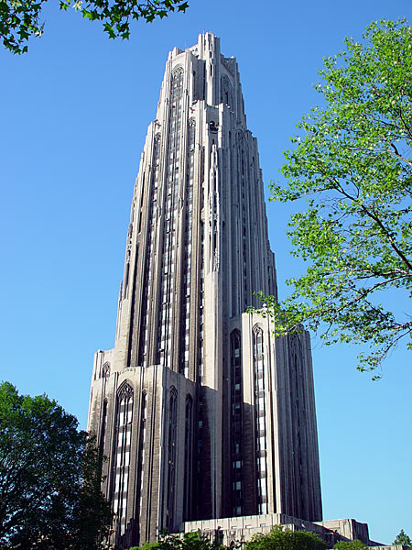
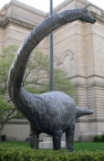
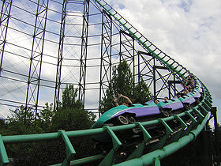
The Parties Split Up
While Auric the car travelled and sightseed around the city, your instructor participated in a dance marathon. Below are some of the sights the car saw itself
Above is the famous Cathedral of Learning of the University Of Pittsburgh. Auric the car knows of this building through his owner’s trainer who went here as an undergraduate
This is dippy the dinosaur which has been displayed since 1907 at Carnegie Mellon’s Academy of Natural Sciences.
And the car participated in riding the Phantom at the Kennywood amusement park which is a National historic site

Slide 5
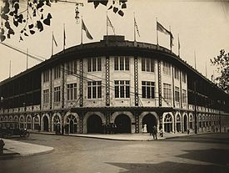
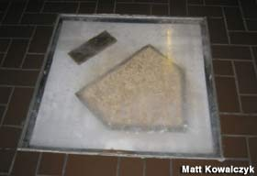
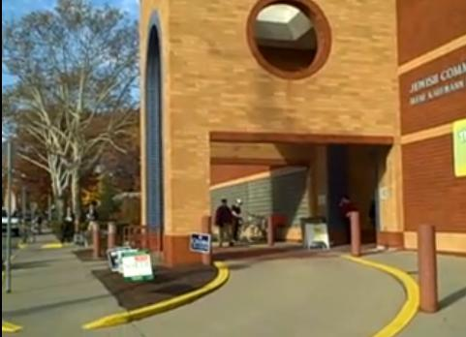
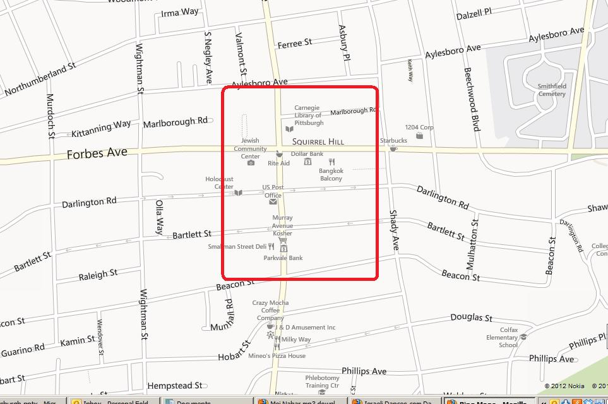
Your Instructor discovers Pittsburgh Today
Pittsburgh today is a vibrant modern city. Below are some pictures taken from the internet and also taken by your instructor while accompanying the car while in the city. To the left is old Forbes field, where the Pirates played for much of the last Century and next to that is the home plate of that stadium encased in the library of the University Of Pittsburgh.
The last picture on the first row is of Pamela’s, one of the best delis in the city and where your instructor ate breakfast on Sunday morning. Pamela goes by the motto, whipped crème with everything. The service station where Auric filled up was not photographed.
Beside Auric the car’s travels, your instructor incidentally had made provision to attend an Israeli dance marathon that weekend in this city. The last picture (first picture second row) shows the facility where the marathontook place.
An area map of squirrel hill is provided at the end
Notes:
pittf.jpg, pittg.jpg, pitth.jpg, pitti.jpg

Slide 6
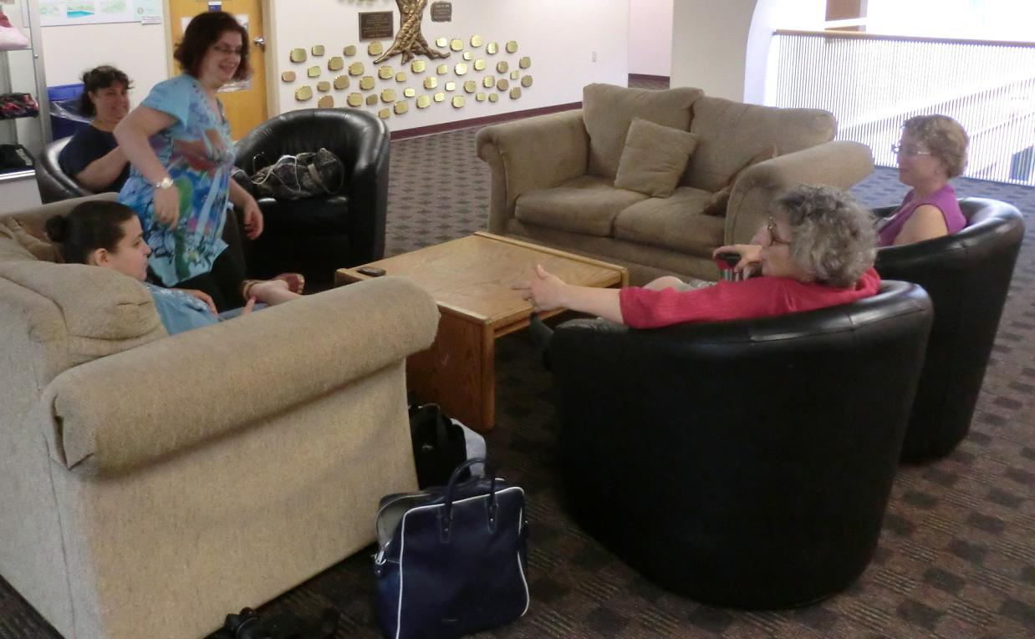
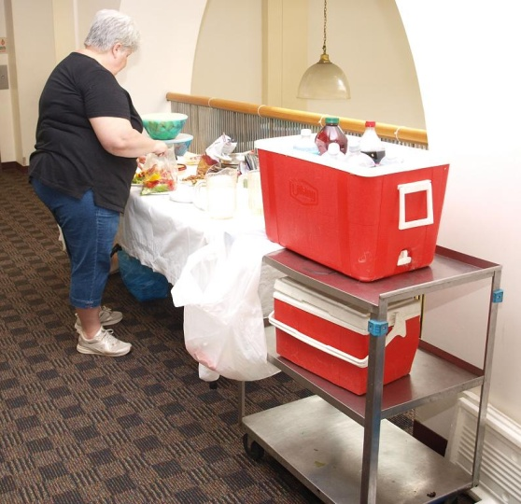
The Marathon Begins
The leaders of the Pittsburgh Israeli dance session, Lynn to the left and Cherie to the right, who played hosts, relax just before the marathon starts
While the food is being prepared to the right, Cherie and Lynn are joined by other dancers.
Notes:
pitt1.jpg, pitt2.jpg, pitt3.jpg, pitt4.jpg

Slide 7
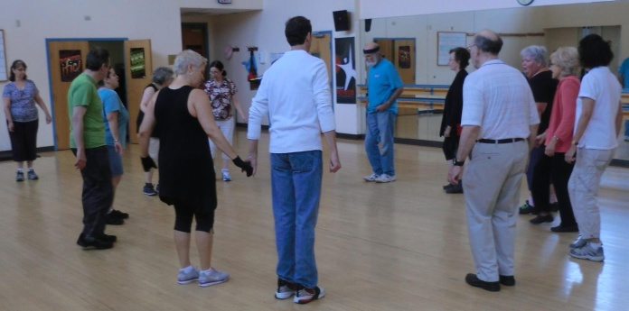
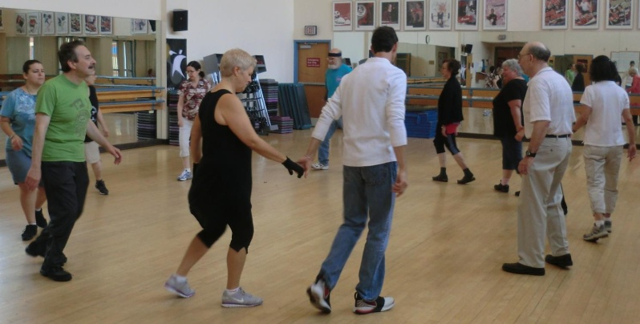
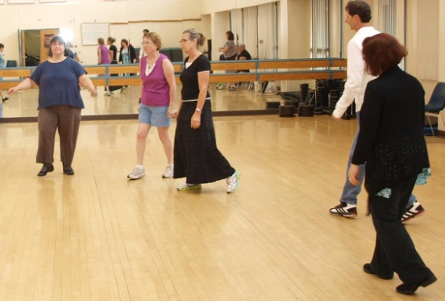
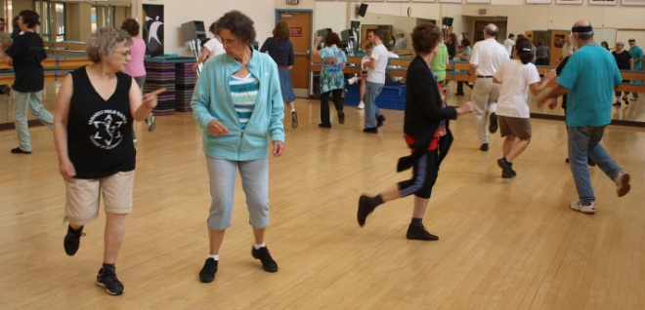
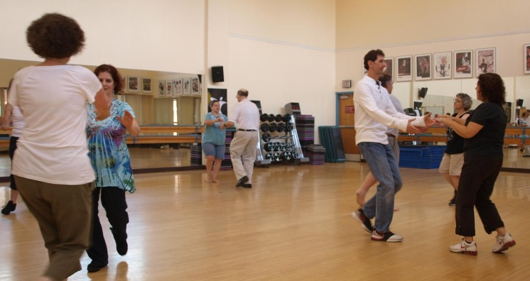
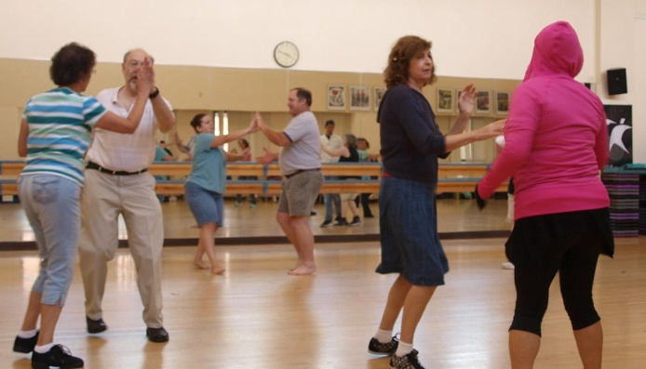
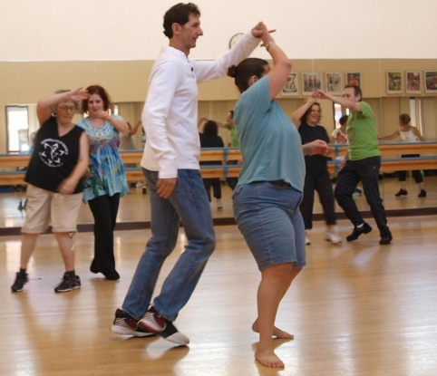
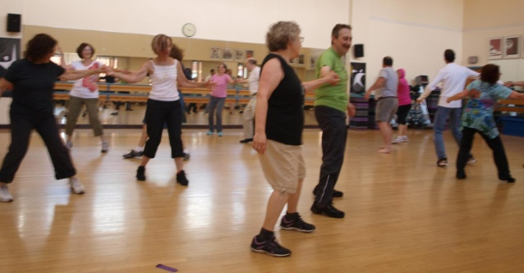
The pictures above show some early circle dances. At this point we have some Pittsburgh dancers supplemented with several dancers from Cleveland. Every piece of music being played has specific choreographed steps
Below (and the right) are pictures taken later at the partner dancing. As opposed to ballroom dancing, every step of this type of dancing is choreographed. Given this, the choreographers tend to create more ‘violent’ turns
Notes:
pitt9,pitt10,pitt11,pitt21, pitt25,pitt26,pitt27,pitt28

Slide 8
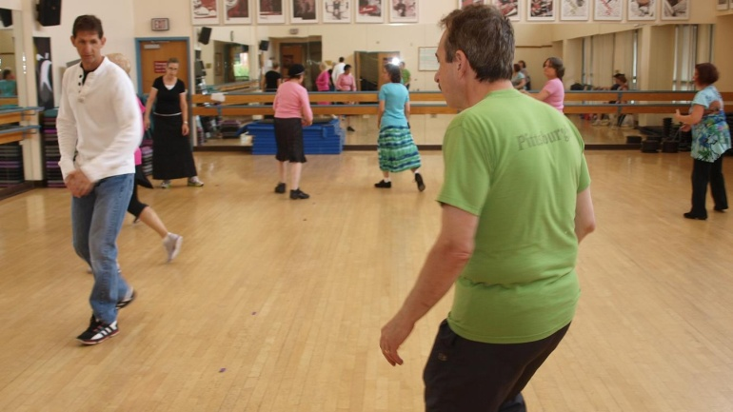
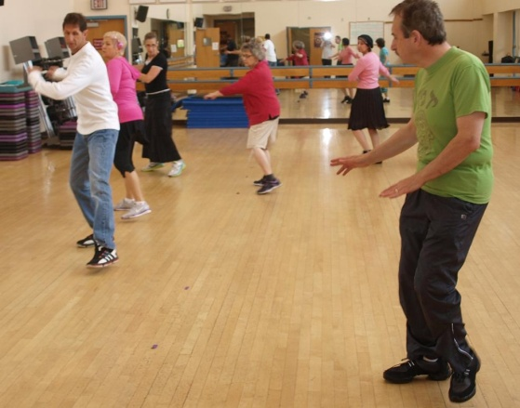
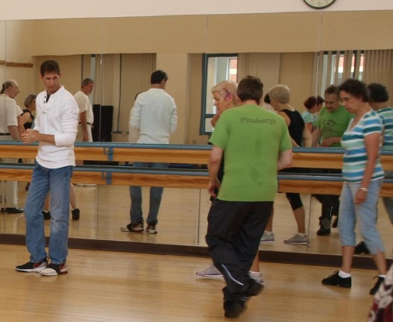
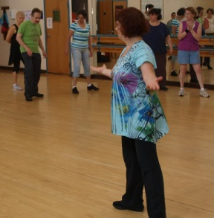
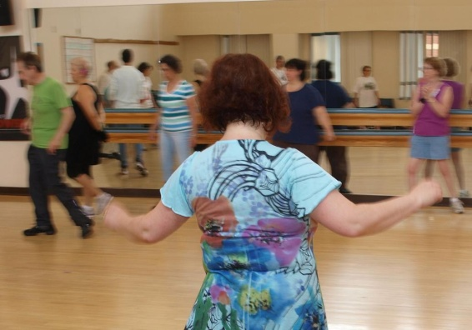
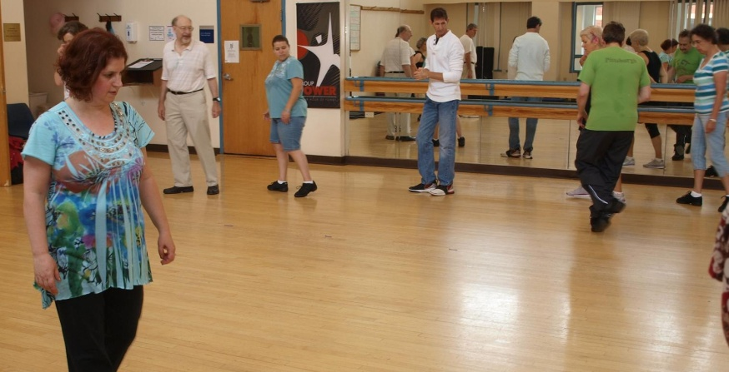
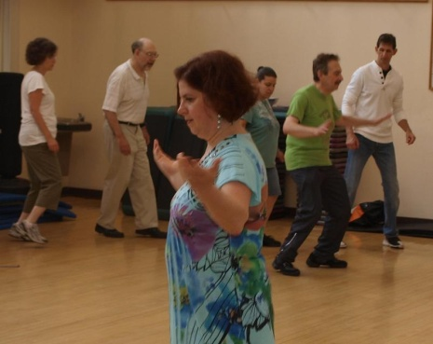
Teaching at the Powwow.
At any Israeli dance marathon, teaching is an essential element. There are currently more than 7000 choreographed Israeli dances and every year adds several hundred to this list. Above, we see Myles, who leads another Pittsburgh session, teaching a dance.
As Myles is teaching, he is joined inside the circle by Lynn who mirrors his steps to the circle.
This is not the only time that Lynn is within the circle. Three dances were taught and Lynn was involved in each
Notes:
pitt12, pitt13, pitt14, pitt15, pitt16, pitt17, pitt18

Slide 9
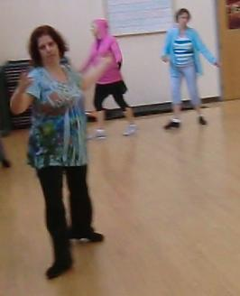
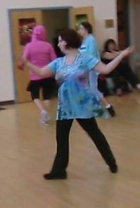
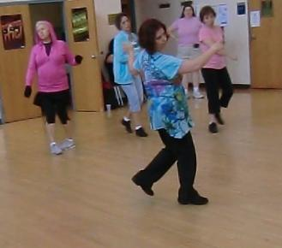
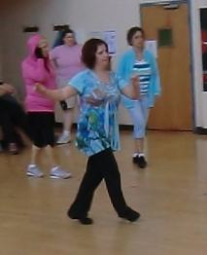
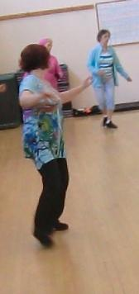
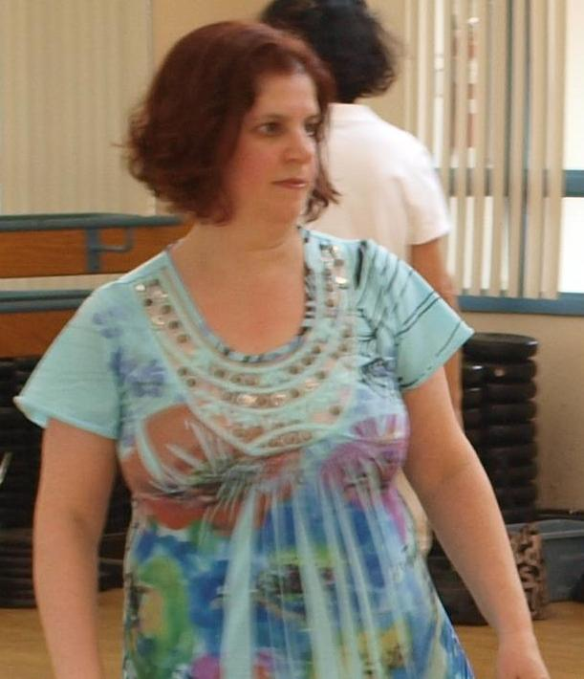
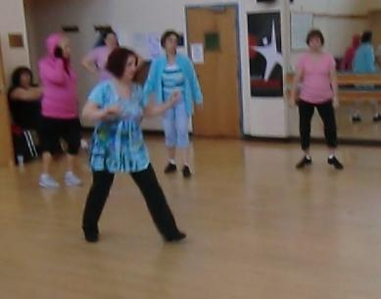
Let’s look at Lynn
Israeli dance is acknowledged to have a steep learning curve. Your instructor has dealt with this genre of dance for 10 years and still considers himself an advanced beginner.
So one is impressed by a relative newcomer who becomes proficient quickly.
Lynn is such an example having about 3 years worth of israeli dance experience. Yet she has become the dance leader for the Pittsburgh session and in these pictures is part of the demonstration of Mei Nahar, a 2012 dance choreographed by Yaron Ben Shimron from music created by Idan Raichel
Notes:
lynn, lynn2, lynn3, lynn4, lynn5, lynn7, lynn8, lynn10

Slide 10
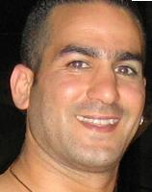
About Mei Nahar
This slide concentrates on the dance, Mei Nahar, which was one of the dances taught. This slide is about its creation both as a song and dance
Idan Raichel (and the Idan Raichel project that he originated and leads), attempts to fuse various themes into music. This song was composed in 2008 for the album, Bein Kirot Beity
Choreographed in 2011 by Yaron Ben Shichon
Dance was demonstrated in the Phila area in March, 2012
Notes:
yaron ben simchon.jpg, idan Raichal.jpg

